Slide 1
Southern Water: East Sussex update 7 May 2025

Slide 2
Agenda
Welcome
You said, we did
PR24 / CMA appeal update
Year 1 investment
Support for customers with bill increases
Clean Rivers and Seas Task Force
Bathing water – preparation for the new season
Water Resources
AOB

Slide 3
You said, we did – working with East Sussex stakeholders
Tour and meeting held with Lewes District Council and the Waste Team – 31 March
Fairlight Customer Drop In Event – 6 February
Delivered a session with Wealden DC and Future Growth Team – 25 February
Hastings Compensation Update and regular meetings held with stakeholders
Hellingly Flood Forum – 4 April

Slide 4

Our Business Plan – 2025 to 2030
As you know, in December 2024 we received our Final Determination from Ofwat for our Business Plan for the period April 2025 – March 2030.
After very careful consideration, our board decided to appeal Ofwat’s Final Determination to the Competition and Markets Authority (CMA).
We felt Ofwat’s Final Determination would not enable us to deliver the environmental and performance improvements and new infrastructure that our customers and communities rightly expect.
It is important to note, the CMA appeal will not affect customer bills for 2025-26.

Slide 5
CMA Appeal – where we are
Last week Ofwat submitted its Statement of Case (SOC) to the CMA on disputing company cases.
The CMA appeal process does not hinder plans for 2025-26, which will be delivered as laid out in our Business Plan 2025-30.
The CMA appeals process is due to be completed before the end of the calendar year 2025.
During the appeal process, and to continue advancing investment in the improvements and new infrastructure our network and assets need, we’ve also announced our intention to raise £900million of new equity from our investors.

Slide 6
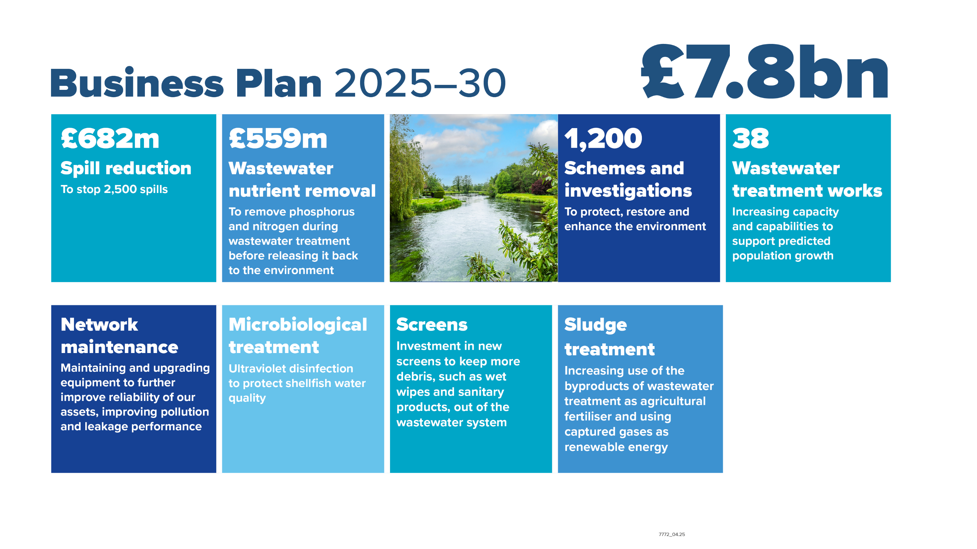

Slide 7
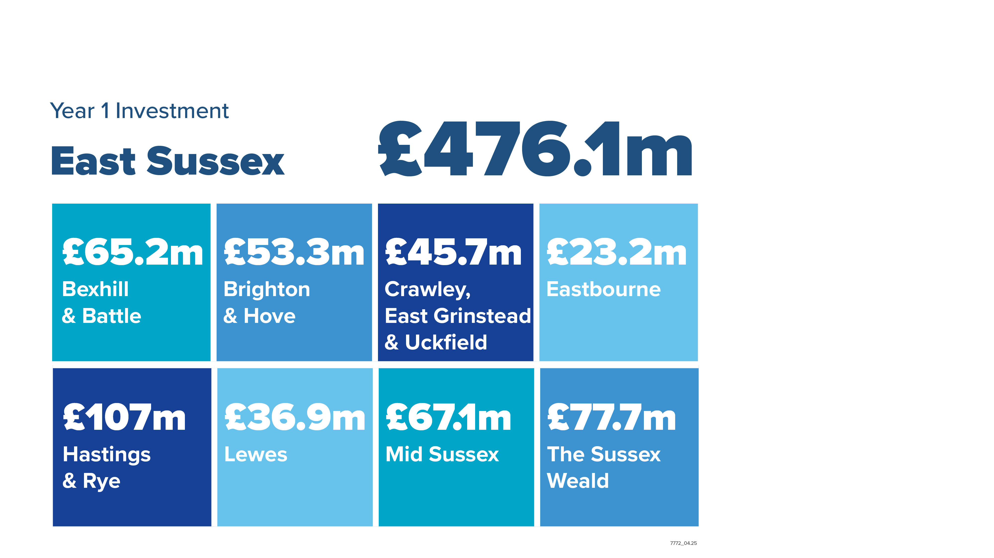

Slide 8
Supporting our Customers Ashley Marshman, Head of Customer Service

Slide 9
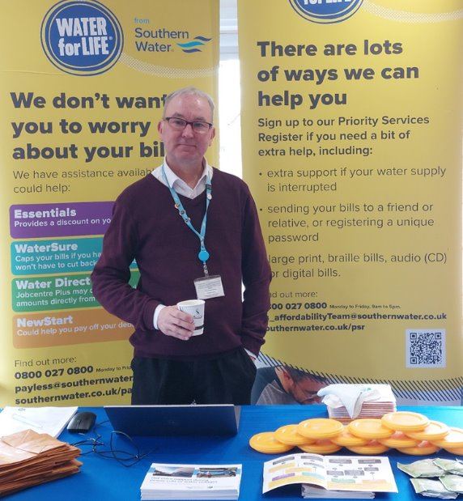
Support for our customers with their bills
Over the next five years we are offering more support for customers than ever before with a £235 million support package for those in the most vulnerable of circumstances.
Our Essentials tariff, currently supports more than 150,000 households, will rise to approximately 180,000 households by 2030.
Our Hardship Fund is planned to increase to £1.25m and our Priority Services Register to 20% of our customer base (currently 16%).
We have spoken to our Sussex customers about their options at more than 160 engagements across the county in the last year.

Slide 10
Essentials Tariff
In place to provide a discount for future charges for customers who meet the eligibility criteria.
Assessed on a total housing income threshold of less than £22,020 per year
We don't include the following as income; personal independence payment, attendance allowance, disability living allowance.
Income threshold | Tariff Band | Bill Discount %
£3,080 to £22,020 | 1 | 45%
£2,600 to £3,079 | 2 | 65%
Less than £2,599 | 3 | 90%
Any households who are all in receipt of Pension Credit will automatically qualify for a fixed discount of 45% provided they do not have savings above £16,000

Slide 11
Clean Rivers and Seas Task Force East Sussex update

Slide 12
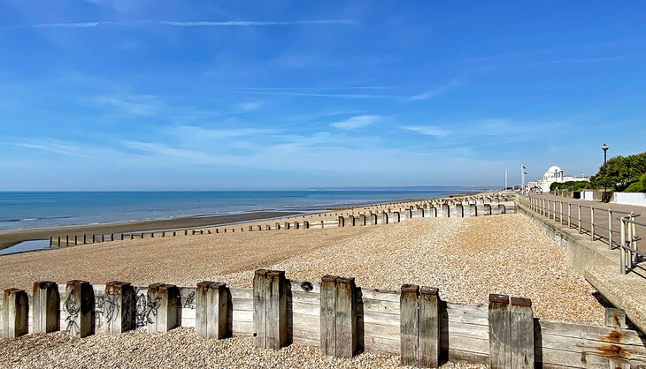
Our progress in East Sussex and 2025-2030 plans

Slide 13

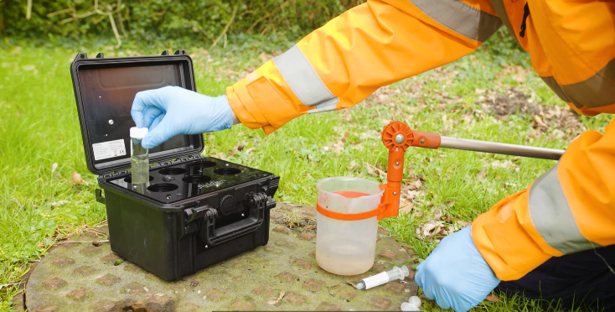
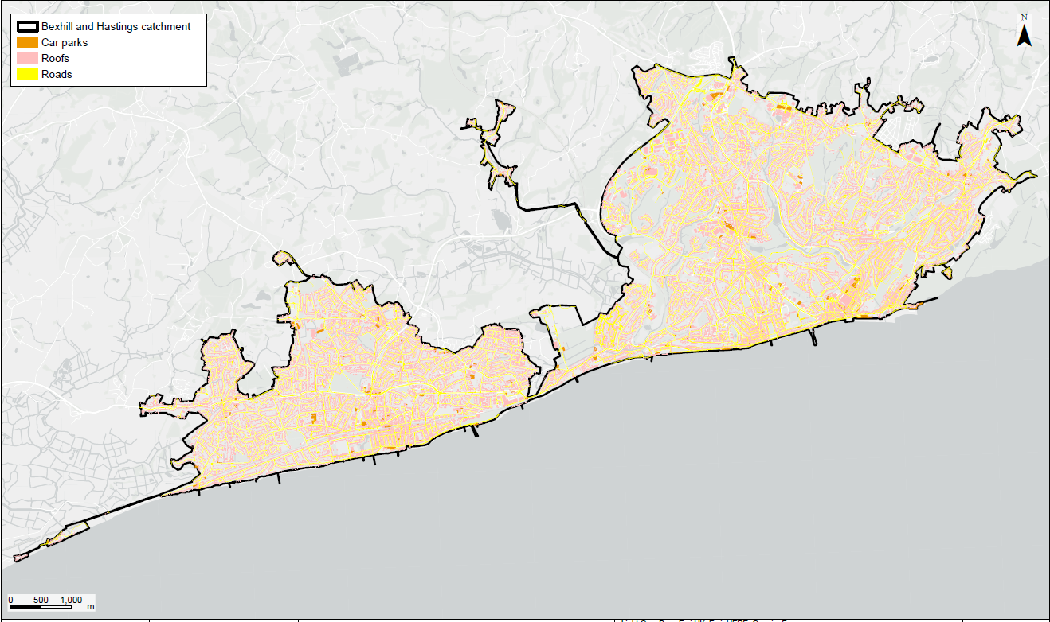
Working in partnership
Rivers and Seas Watch full launched – near-real time information for all storm overflow, including inland. Co-created with stakeholders and users
Illegal connections team have been working tirelessly in East Sussex, and very pleased to see the bathing water classification in Hastings go from ‘sufficient’ in 2019 to ‘excellent’ in 2024. Working hard in Bexhill to improve the bathing water quality
Working with East Sussex County Council to explore potential highway SuDS scheme – held two workshops and work ongoing to build a potential programme, managing surface water in communities. Already funded £60k for SuDS in schools

Slide 14
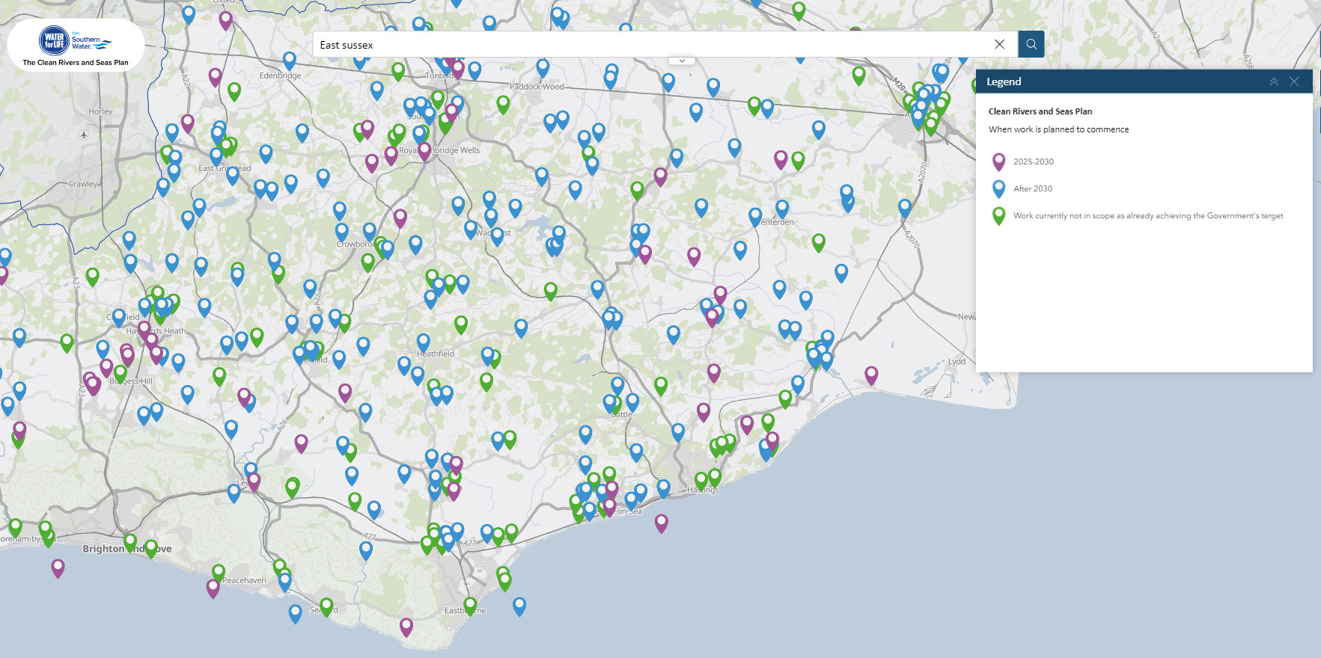
Overflows in East Sussex
Key stats
199 | Storm Overflows in East Sussex
132 | Require work/investment to achieve Govt. targets before 2050
22 | Overflows working on between 2025-2030
Approximately £220m investment in next five years
southernwater.co.uk/water-for-life/clean-rivers-and-seas-plan/map
Notes:
35 CSOs planned to work on AMP 8 and AMP 9 combined

Slide 15
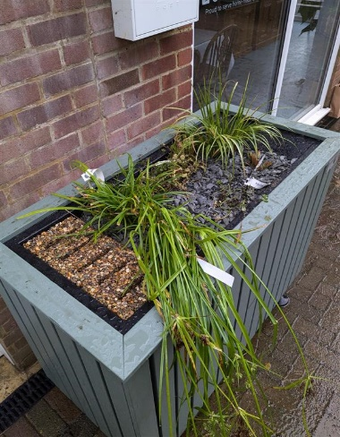
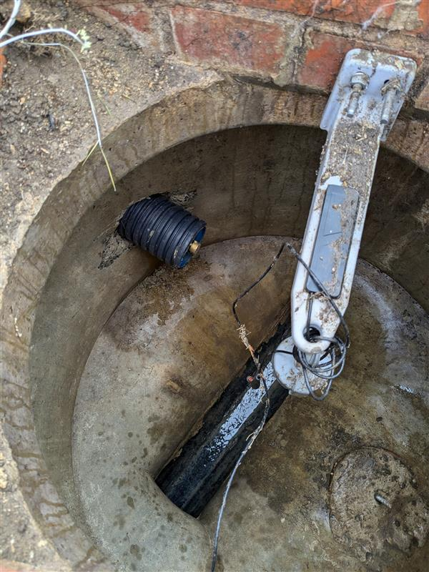
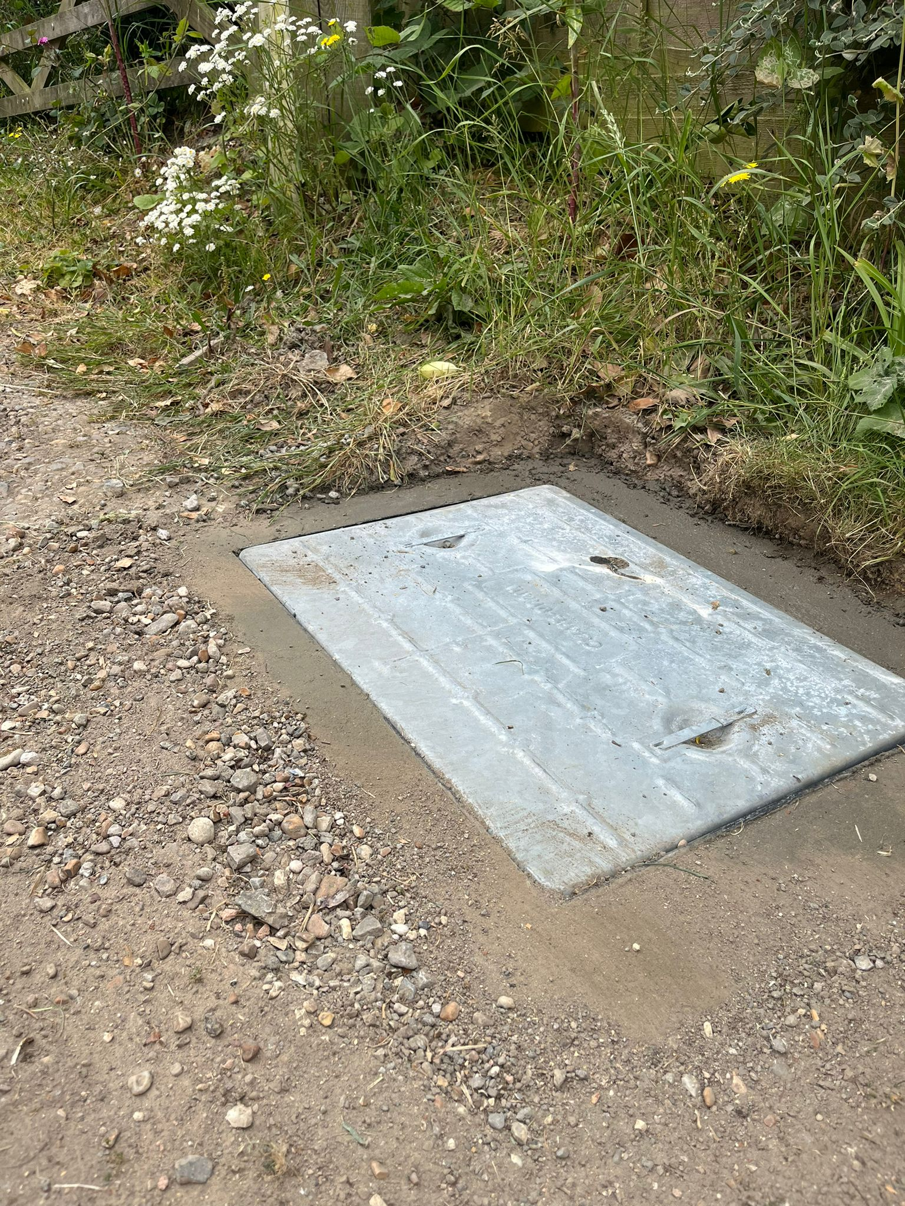
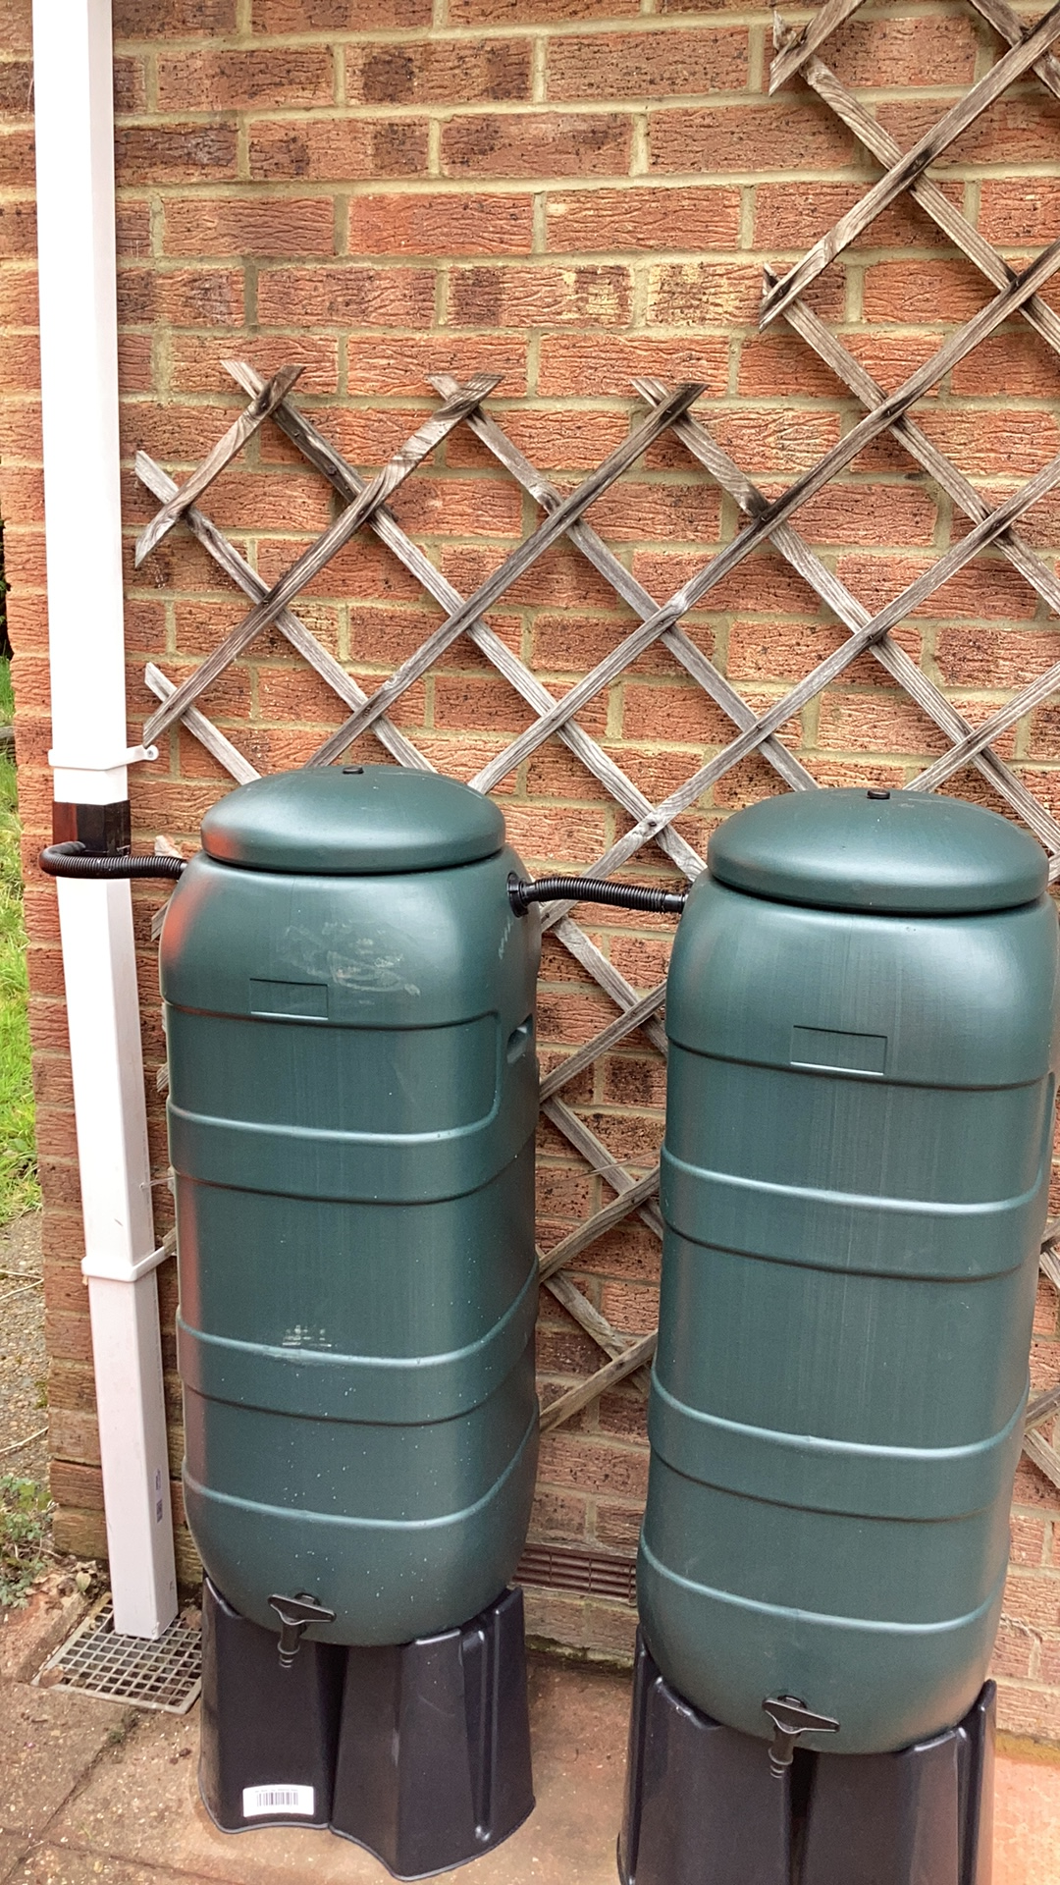
Fairlight -East Sussex
341 slow the flow water butts installed managing 0.6Ha
Sealed 1850m of damaged sewer
Replacement of damaged manholes that posed a H&S risk
Fairlight WTW-storm return pumps optimised
A new self-assemble planter at the coastguard café to manage up an area of 50m
Cleaning and remedial works to our CSOs
Investigations into manhole chamber condition along sealed sewer lines
Knowle Road illegal surface water connection rectified-managing 0.54Ha

Slide 16
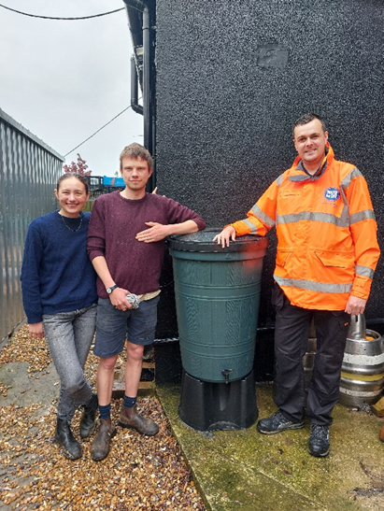
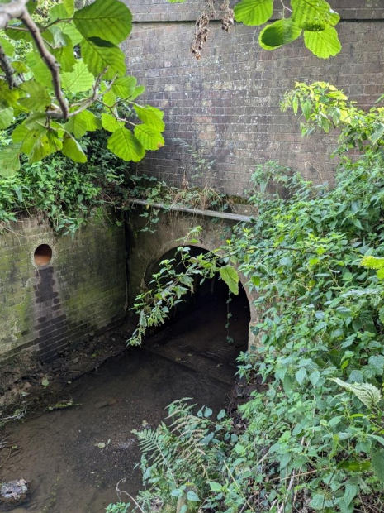
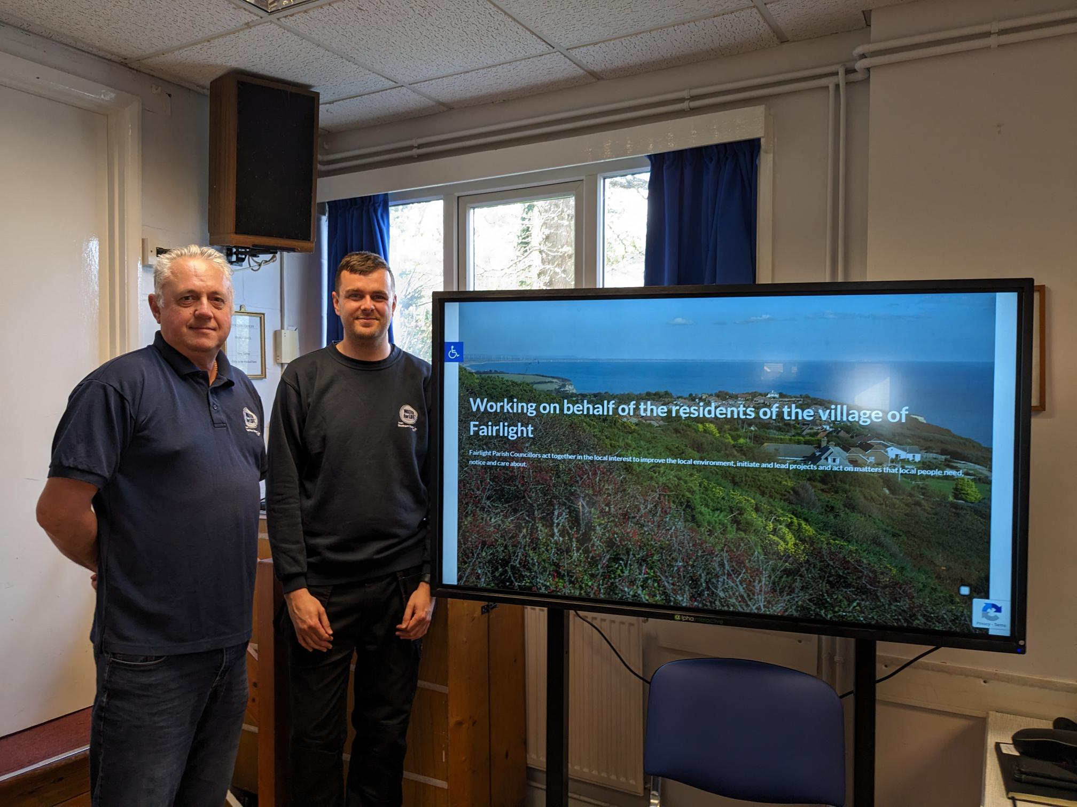
Fairlight -Engagement
Continue to build on our customer engagement through customer events
Continue working together with both local and national authorities
Supporting the Future Landscape Trust with funding for surveys and the installation of flow monitoring to the Marsham Brook

Slide 17
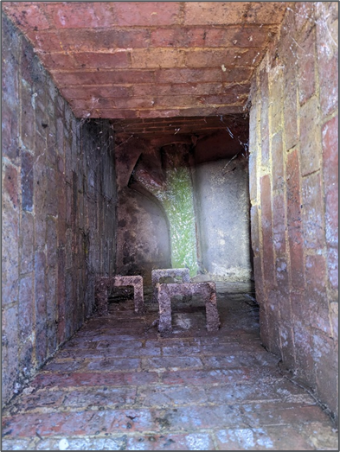
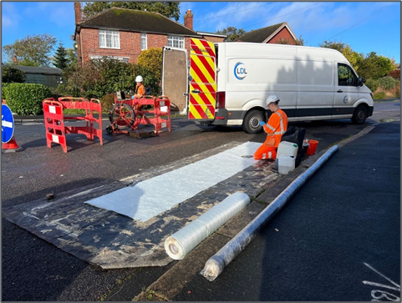
AMP8 2025-2030
Over the next five years as the Clean Rivers and Seas Task Force grows, we will be expanding out into more areas in East Sussex
Continuing with a programme of Sewer Sealing the main trunk sewers in Fairlight a further 2.1km , with the possibility of expanding this out into the wider catchment
Investigating the condition of the manholes in Fairlight for surface water infiltration and sealing where required
Redundant Sewer WTW capped off and remaining 125m to the WTW to be sealed Spring 2025-

Slide 18
Bathing Waters: East Sussex update

Slide 19
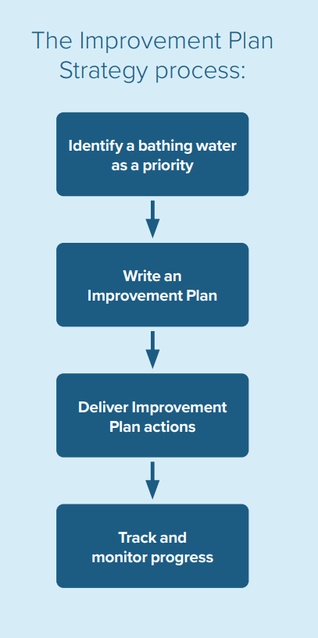

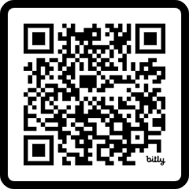
What is Southern Water’s role
in bathing water quality?
We recognise the key role we have in trying to improve bathing water quality.
We are a key custodian, alongside others like the Environment Agency. The local authorities are responsible for public health.
It’s vital we work with local partners to tackle these issues collaboratively, and that we work closely with the Environment Agency and other regulators to monitor improvements.
Work to improve bathing water quality has been defined in our Improvement Plan Strategy, which prioritises key locations for targeted work based on a number of factors.
Check out our bathing water pages!
19

Slide 20
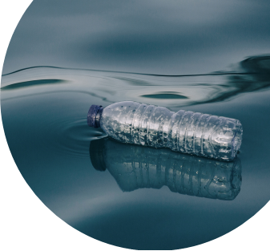
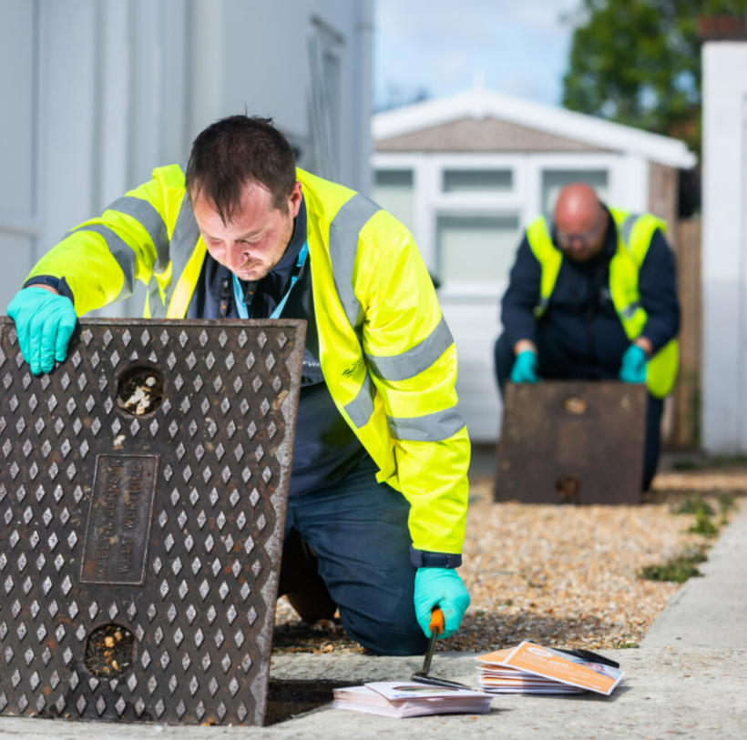

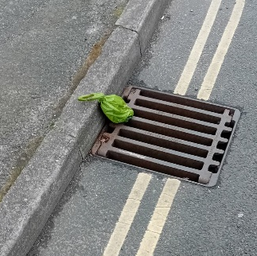
What can impact bathing water quality?
There are a variety of issues which have the potential to impact water quality. For us, these include:
Leaking assets
Blockages
Illegal connections
Storm overflow releases.
Other sources of pollution outside of our control include:
Road, farming and industrial surface water run-off
Waste from other water and beach users
Seabirds also have an impact.

Slide 21
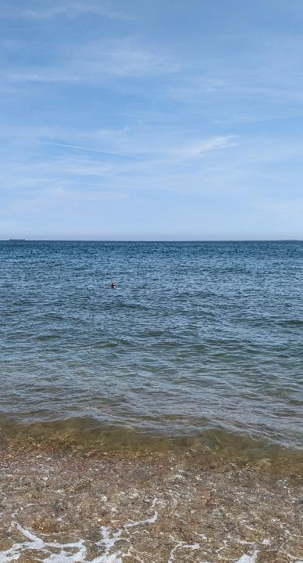

Bathing water quality
Test data shows that storm overflow releases do not always cause poor bathing water quality. There are several other factors that can impact bathing water quality including:
Agricultural/farm run-off which can include pesticides, animal medicines and animal waste
Blockages and other asset issues which can cause serious pollution
Private sewer issues such as misconnections and illegal connections which cause sewage to end up in bathing waters
Seabird and other animal waste causing spikes in bacteria concentration
Disposal of waste/liquid contaminants down surface water drains which go directly out to sea unfiltered and untreated
Seaweed and algal blooms protecting bacteria and allowing them to live longer and sometimes providing a medium for them to reproduce
Marine activities such as discharging on-board toilet and hygiene facilities
Road surface run-off which at scale, can have a significant impact on water quality
21
Notes:
Our programme of various investigations over the past 12 months has uncovered significant issues, including 31 illegally connected properties, with 12 having toilet waste connected to the surface water system which goes directly out to sea. Since 2019 our in-house team has now identified 290 illegally connected properties with 918 separate facilities. That includes 135 toilets which had potentially been letting out 2,700,000 litres of raw sewage straight into streams or onto beaches. We’re always striving for improvement, and investment totalling £130k has been spent on CCTV crawler devices to help spot issues which have the potential to impact bathing water quality

Slide 22
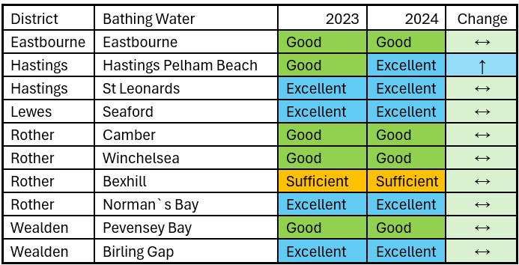
East Sussex Bathing Water Classifications

Slide 23
Bathing water deliverables in East Sussex
Hastings Pelham beach
Bexhill
Survey of the surface water sewer network (completed)
63 illegal connections found and resolved (143 facilities)
700+ meters of foul sewer lining completed, and 36 separate sewer issues resolved in the King Edward Avenue catchment
Ongoing collaboration with Hastings Borough Council
Continued investigations focussing on Ashford Road surface water outfall
S105A foul sewer leaking into the surface water sewer resolved
A damaged private foul sewer leaking into the surface water sewer resolved
Comprehensive survey of the surface water sewer network (completed)
12 illegally connected properties identified, only one (recently found) issue is outstanding
We continue to monitor the surface water sewer network for evidence of pollutants
Bexhill Surface water outfall sign pilot
Egerton Park Lake sediment sampling has highlighted elevated levels of E.coli. We’re working with partners in local authorities and the Environment Agency to resolve this.
St Leonards-on-sea
Comprehensive survey of the surface water sewer network
38 Illegally connected properties identified and resolved
Stonehouse Drive. Issue with the wastewater pumping station (WPS) and surface water pumping station (SPS) causing leaks of foul waste to the surface water identified (resolved)#
Public foul sewer leaking into surface water sewer identified (resolved)
Eastbourne
Comprehensive survey of the surface water sewer network completed
Following the discovery and resolution of a local café’s misconnection, monitoring of the surface water sewer is continuing, and showing positive improvements
23
Notes:
Read more in the bathing water report

Slide 24

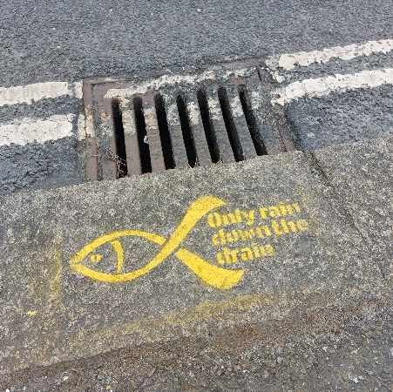

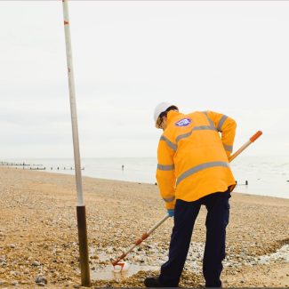
Bathing water season preparation
Ahead of the 2025 season, health checks are completed at all wastewater pumping stations (WPS) and wastewater treatment works (WTW) that have the potential to impact bathing water quality
Pro-active CCTV will be undertaken on the sewer network serving Bexhill to check for defects that can be resolved quickly.
Resources in the Southern Water Bathing Water team have been increased, allowing for a more agile approach to addressing deteriorating water quality in 2025 and beyond.
Collaboration will continue with partners, local authorities and the Environment Agency, particularly in areas where bathing water quality is at risk.

Slide 25
Water Capex investment
East Sussex update
May 2025

Slide 26
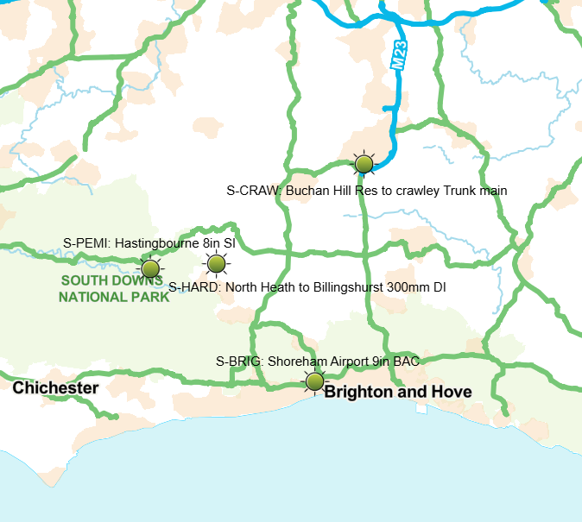
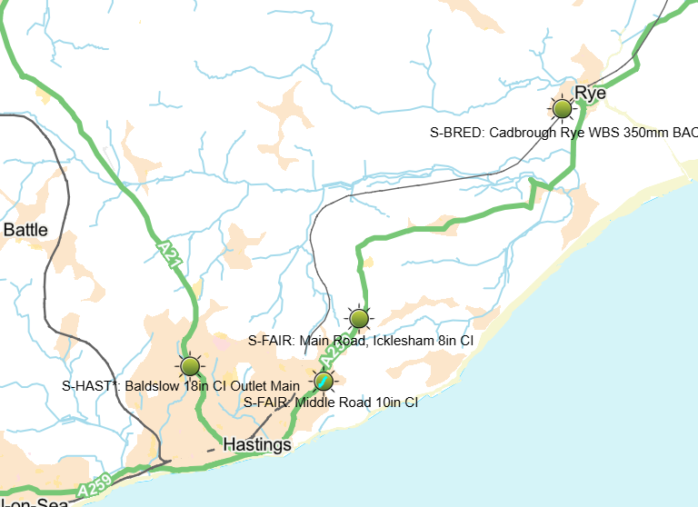
Trunk Mains Programme – Central & Hastings
Proposed spend on trunk mains:
£1m for already identified schemes across the region, including installation of valves and installation of bypasses
£1m per year funding to resolve issues on trunk mains, identified through operational activities and trunk main walking
4 sites identified for valve installation / replacement in the Central area
All schemes shown under review and not finalised.

Slide 27
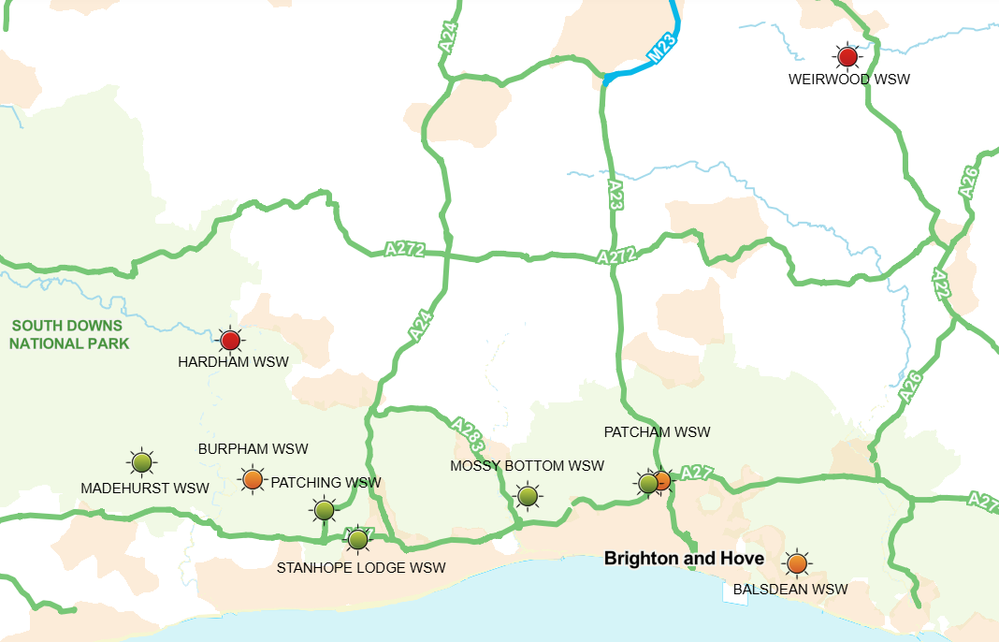
Key Production Site schemes in AMP8 - Central
We will be investing over £50m to rebuild Weirwood WSW
We will be investing £10m in nitrate schemes by:
Installing nitrate plants at Mossy Bottom WSW and Patcham WSW
We will be investing £6m in the Disinfection Future Resilience Programme (DFRP) by:
Installing permanent crypto management at Patcham WSW
Increasing contact time for virus management at Balsdean WSW

Slide 28
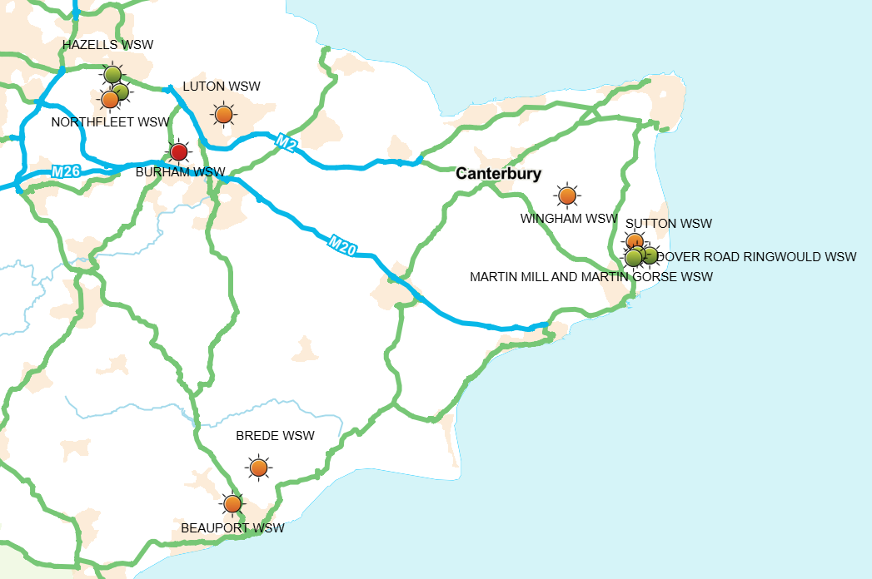
Key Production Site schemes in AMP8 - Hastings
1. We will be investing £35m in the Hastings zone, on strategic mains refurbishment, treatment processes and system upgrades
2. We will be investing £5m in the Disinfection Future Resilience Programme (DFRP) by:
Increasing contact time for virus management at Brede and Beauport
3. Rebuilding the Rapid Gravity Filters at Brede at ~£25m
This is part of a package summing up to ~£80m

Slide 29
Water leakage in Sussex
Total leak repairs 2022/23
Total leak repairs 2023/24
Total leak repairs 2024/25
 | Sussex
Bursts | 663
Customer Leaks | 256
Network Leaks | 7,576
Total | 8,495
 | Sussex
Bursts | 533
Customer Leaks | 1,201
Network Leaks | 7,241
Total | 8,975
 | Sussex
Bursts | 544
Customer Leaks | 1,367
Network Leaks | 6,534
Total | 8,445

Slide 30
Water leakage in Hastings
Total leak repairs 2023/24
Total leak repairs 2024/25
 | Sussex
Bursts | 73
Customer Leaks | 75
Network Leaks | 706
Total | 854
 | Sussex
Bursts | 110
Customer Leaks | 43
Network Leaks | 903
Total | 1,056

Slide 31
Water efficiency .......

Slide 32
Share your thoughts

Slide 33
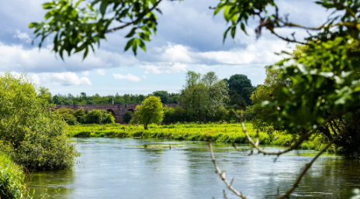

You can vote at Slido.com with the code
#3605 824

Slide 34
AOB

